Slide 1
Food Habitat RecognitionChatbot System(A FIS sub module)
Ch. Aashvik

Slide 2
Objective:
To project the food information related to fishes using a chatbot so as to reduce the search work for customers.

Slide 3
Literature Survey
The survey on artificial intelligence using chatbot works on various purposes and makes human life easier in daily requirements. By chatbot research papers we concluded that they are very useful in various forms like communication, agriculture, business etc.
We are making a model which helps a customer to know the type of food a fish consumes.
Also we will collect customer feedback so that we can use it to make an analysis to get more number of investors and customers.

Slide 4
Abstract:
Our model deals about the food details of the fish. We see many sites about fish data but they won’t provide multiple details. So, we are coming with a solution for that. This model is used to give awareness on what kind of food does a specific fish rely on.

Slide 5
Tools Used:
Python, HTML, CSS and Javascript(chatbot building)
WIX(Webpage where we integrate our chatbot)

Slide 6
Types of Chatbots
Support Chatbot(A person needs to be online everytime)
Skills Chatbot(Our model)
Assistant Chatbot(Stands between the above two chatbots)

Slide 7
Real-Time Tracking
Bots eliminate long service queues and share a real-time status of the order to the customers.
Reduced waiting time and real-time information in a conversational manner result in an enhanced customer experience and thus improved customer relationships.

Slide 8
24/7 Assistance
We don’t need a dedicated human support to answer customer queries. Bots offer a ceaseless support round the clock.

Slide 9
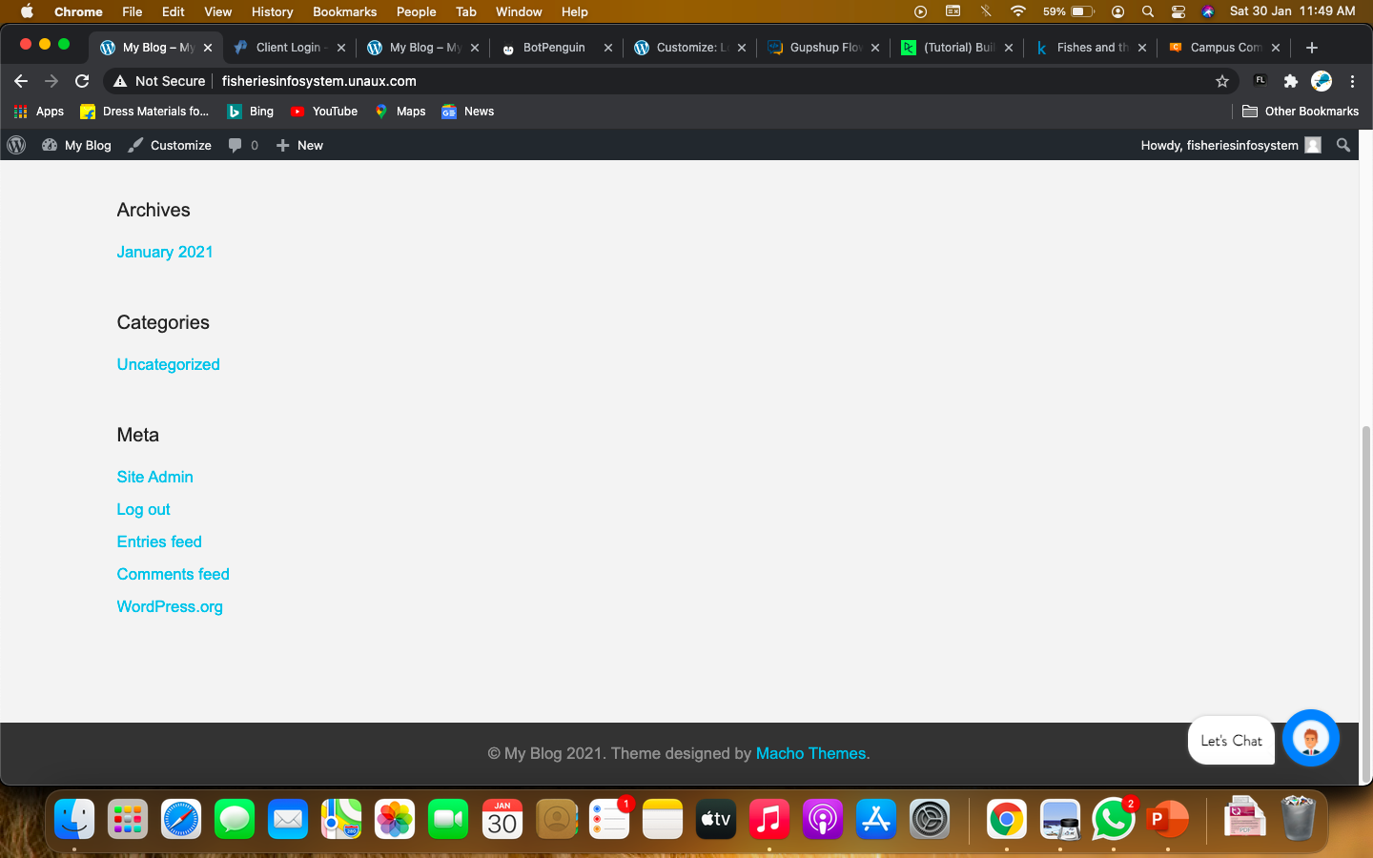
Basic Outlook of my model(webpage oriented):

Slide 10
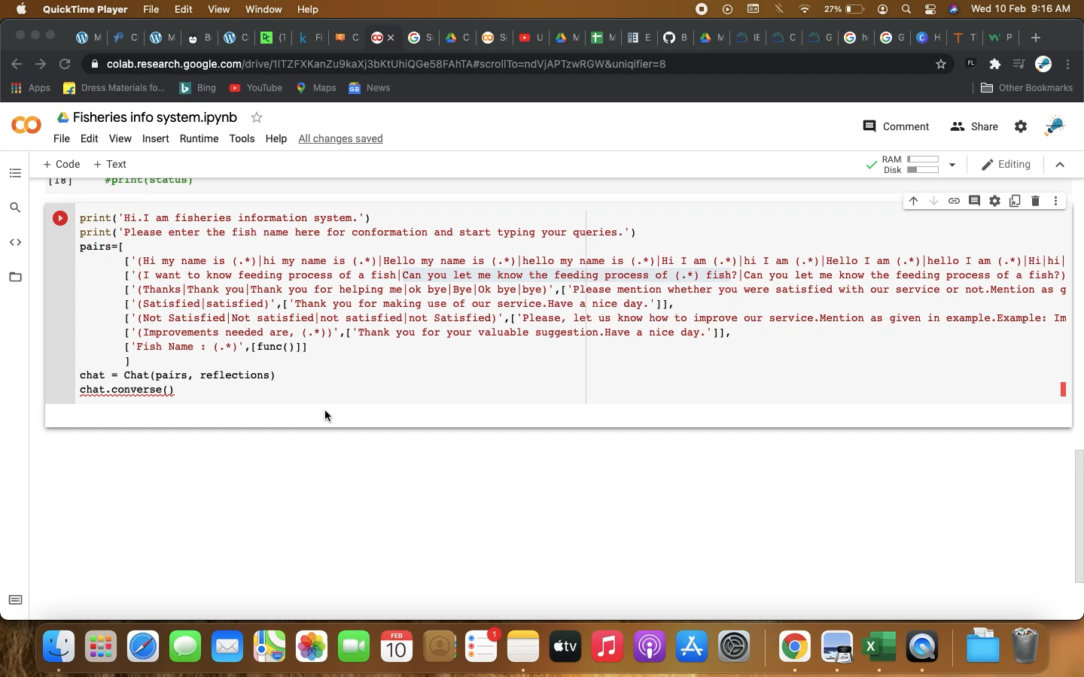
Demo video of Chatbot Working

Slide 11
References:
https://www.datacamp.com/community/tutorials/building-a-chatbot-using-chatterbot
https://towardsdatascience.com/chatbots-are-cool-a-framework-using-python-part-1-overview-7c69af7a7439
https://wordpress.org/plugins/chatbot/#:~:text=You%20can%20also%20integrate%20this,with%20your%20Dialogflow%20V2%20agent
https://www.edureka.co/blog/how-to-make-a-chatbot-in-python/
https://www.chatcompose.com/connect-api-chatbot.html

Slide 12

Thank you

